Slide 1


<Ivan T.>
<16.08.2025>

Slide 2
Outline
Executive Summary
Introduction
Methodology
Results
Conclusion

Slide 3
Executive Summary
Summary of methodologies: data collection, data wrangling, EDA and visualization, design and evaluation of predictive models.
Summary of all results: a best performing predictive model was found, as well as features correlated to the target variable.

Slide 4
Introduction
Project background and context: SpaceY, a competitor of SpaceX funded by Billionaire industrialist Allon Mask, is looking the predict the cost of each rocket lunch. The cost of each lunch has a large contribution of whether the first stage lunch manages to land successfully and hence can be reused for future lunches. If it lands successfully, it reduces the cost by about 100 million out of160 million. Hence, determining whether or not the first stage lunch manages to land is an important factor for the cost of the launch.
Problems you want to find answers: using data from SpaceX launches, we would like to construct a classifier model that predicts if the first stage of the lunch will land successfully or not. Along the way it would be nice to build an interpretable model, where we can easily determine which features have important contributions to the success of the landing.

Slide 5

Section 1

Slide 6
Methodology
Executive Summary:
Data collection methodology:
Collect the relevant data via the SpaceX API and web scraping.
Perform data wrangling
Deal with missing value and filtering of data.
Perform exploratory data analysis (EDA) using visualization and SQL
Perform interactive visual analytics using Folium and Plotly Dash
Perform predictive analysis using classification models
How to build, tune, evaluate classification models

Slide 7

Data Collection
The data collection was performed via two methods: using the SpaceX API, and via web scraping.
Data Collection
SpaceX API
Web scraping

Slide 8
Data Collection – SpaceX API
In the flowchart we represent the API calls that were made.
For more details, the notebook containing the API calls can be found here.
API Calls
Rocket
info
Core
info
Launchpad
info
Payload
info

Slide 9
Data Collection - Scraping
We obtained relevant tables from wikipedia on Falcon 9 launches, which was parsed via BeautifulSoup and then converted to a data frame with Pandas.
For more details, the notebook containing the web scraping process can be found here.
BeautifulSoup
H
HTML tables with info on Falcon 9 launches
Parsing and conversion to Data Frame

Slide 10
Data Wrangling
We studied the counts of launch sites, orbits and mission outcomes, as well as null values.
The target featured, called "Class", was created. It is 0 if the landing of the first stage launch was unsuccessful, and 1 if the landing was successful.
For more details, the notebook containing the data wrangling process can be found here.
Data Wrangling
Study of null-values
Counts of times each launch sites, orbit and mission outcome occurred.
Created the target feature "Class"

Slide 11
EDA with Data Visualization
During the EDA process, the following scatter plots were made: scatter plots of flight number vs payload mass, flight number vs launch site, payload vs launch site, flight number vs orbit type, payload mass vs orbit type. The points were colored according to the "class", in order to determined relations between the success of the launch and the corresponding features.
A bar plot with the success rate of each orbit type was plotted, in order to see which orbits had a high success rate.
A line plot of the average success rate across the years was also plotted, with a clear upwards trend of the success rate, as the years went by.
For more details, the notebook containing the EDA and visualizations can be found here.

Slide 12
We performed SQL querries to determine the following:
Display the names of the unique launch sites in the space mission
Display 5 records where launch sites begin with the string 'CCA'
Display the total payload mass carried by boosters launched by NASA (CRS)
Display average payload mass carried by booster version F9 v1.1
List the date when the first succesful landing outcome in ground pad was acheived.
List the names of the boosters which have success in drone ship and have payload mass greater than 4000 but less than 6000
List the total number of successful and failure mission outcomes
List all the booster_versions that have carried the maximum payload mass, using a subquery with a suitable aggregate function.
List the records which will display the month names, failure landing_outcomes in drone ship ,booster versions, launch_site for the months in year 2015.
Rank the count of landing outcomes (such as Failure (drone ship) or Success (ground pad)) between the date 2010-06-04 and 2017-03-20, in descending order.
For more details, the notebook containing the EDA with SQL can be found here.
EDA with SQL

Slide 13
Build an Interactive Map with Folium
Using Folium, we marked all launch sites on a map, as well as the success/failed launches for each site. Finally, we computed the proximity of one of the launch sites to the nearest coastline.
This allowed us to gain insights on whether factors related to the locations of the launch sites had any relation to the success or failure of the first stage of Falcon 9 launches.
For more information, the notebook containing the interactive maps created with Folium can be found here.

Slide 14
Build a Dashboard with Plotly Dash
For the Dashboard, we included a pie chart showing the number of successful launches of each launch site, as well as a pie chart for each site showing successful vs failed launches.
Additionally, we included a scatter plot of Payload Mass VS class, and colored by the booster type. This plot had a slider to be able to pick the range of the payload mass.
From this plots, we could easily see which launch site had the higher success rate, and under which ranges of the payload where certain boosters more successful than others.
For more details, the Python code of the Dashboard can be found here.

Slide 15
Predictive Analysis (Classification)
GridSearchCV
Several models were trained and evaluated, including a Logistic Regression model, an SVM model, a Decision Tree model, and a KNN model.
The models were fine-tuned using GridSearchCV.
After training, the models were scored in terms of accuracy on the test set, and a best model was chosen.
For more details, the notebook containing the training and evaluating of the models can be found here.
Logistic Regression
KNN
SVM
Decision Tree
et
Evaluate accuracy on test set
Choose best model

Slide 16
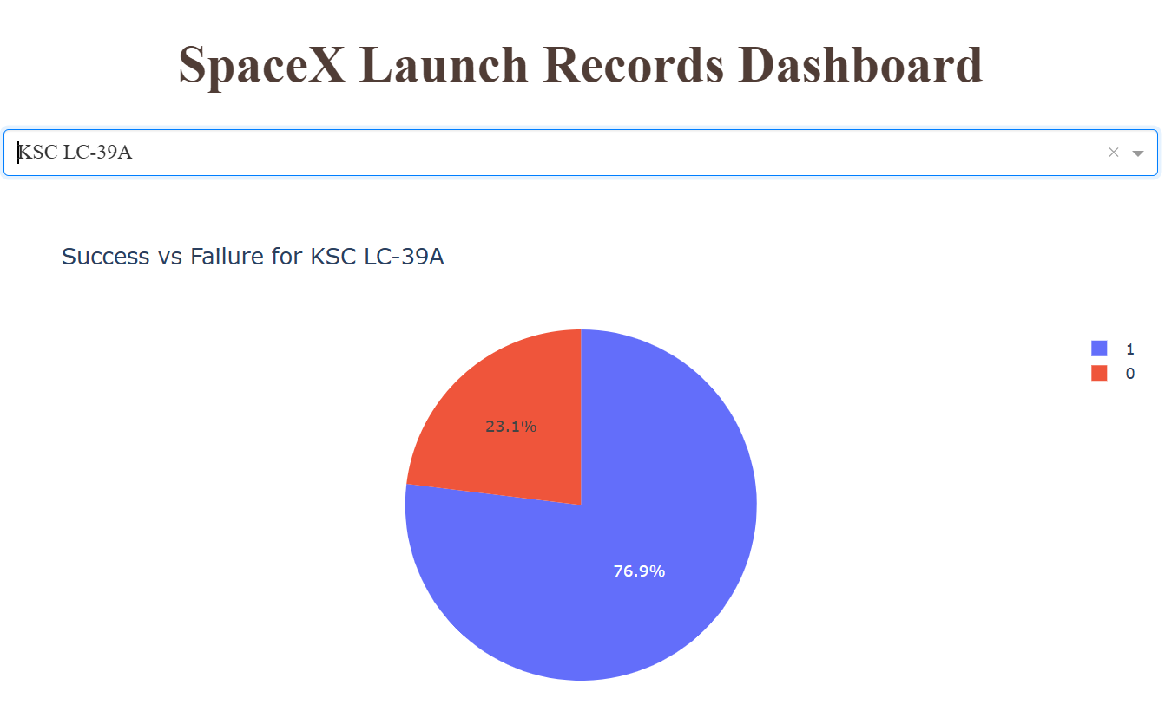
Results
Some EDA results:
The higher the flight number, the higher the success rate of the landing.
As the years go by, the higher the success rate of the landing.
The success rate seems to be linked to the type of orbit, with certain orbits having a perfect success rate, while other have a perfect failure rate.
The launch site seems to also be related to the success rate, with a specific launch site having 76.9% success rate (see figure)
Among all models, the decision tree model performed best, with a test accuracy of 88.9%.

Slide 17

Section 2

Slide 18
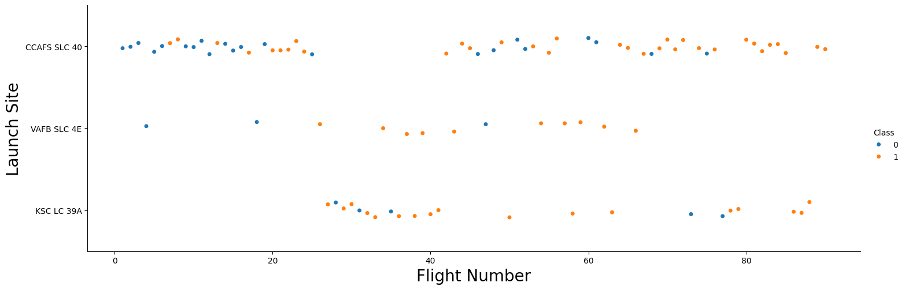
Flight Number vs. Launch Site
Below we do a scatter plot of the Flight Number and Launch Site, with the coloring denoting whether the first stage of the Falcon 9 landed successfully or nor.
From the plot we see that in all launch sites, the higher the flight number, the higher the chance that the first stage of the Falcon 9 landed succesfully.

Slide 19
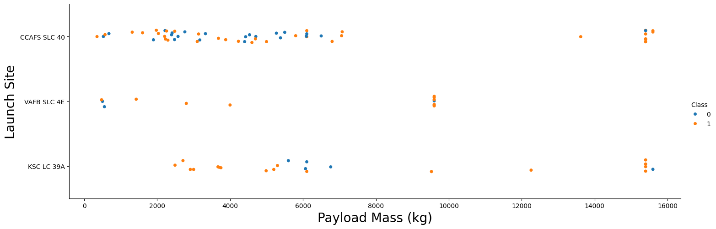
Payload vs. Launch Site
From the scatter plot we see that launches with a payload higher than 8000kg are more likely to be successful.
On the other hand, for lower payloads it is hard to find a general behavior across launch sites, with all three launch sites showing different behaviours.

Slide 20
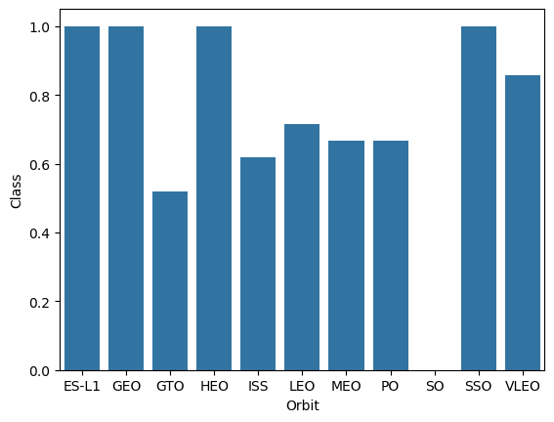
Success Rate vs. Orbit Type
On the bar charts we have the average success rate of each orbit.
In particular, we see that the orbits ES-L1, GEO, HEO and SSO, all have a perfect success rate of 100%, while SO has a 0% success rate.

Slide 21
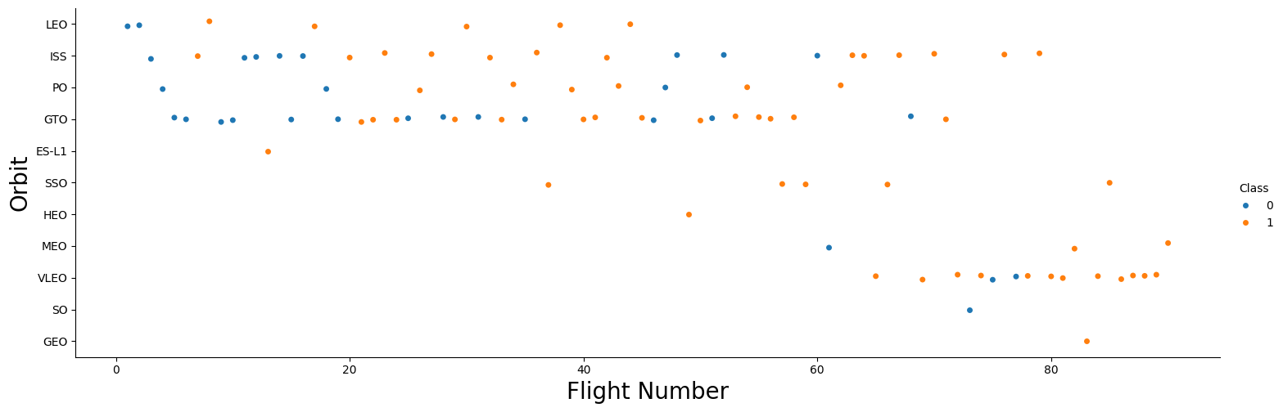
Flight Number vs. Orbit Type
There does not seem to be a general behavior among all orbits in relation to flight number. The success of orbits like LEO seem to be linked to the flight number, but for orbits like GTO there does not seems to be a strong link.

Slide 22
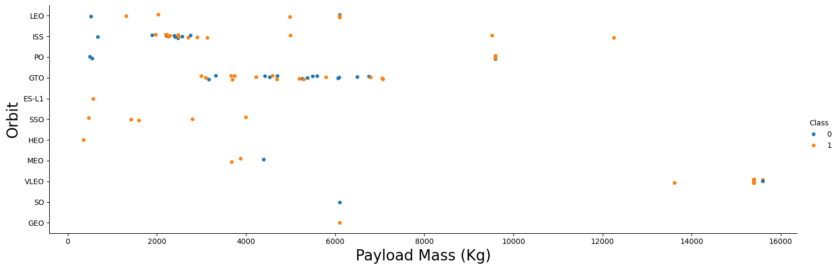
Payload vs. Orbit Type
Orbits like LEO, ISS, and PO seem to be more successful with higher payloads, while the success of orbits like GTO do not seem to be strongly related to the amount of payload.

Slide 23
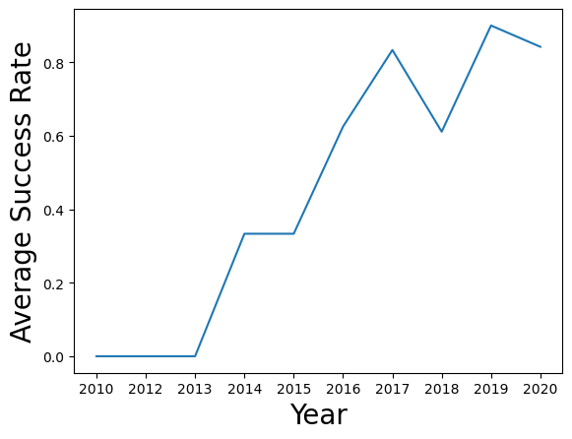
Launch Success Yearly Trend
We see a clear upwards trend of the average success rate as the years go by.

Slide 24
All Launch Site Names
The unique launch site names are given in the table below.
These were found using the SQL query: "SELECT DISTINCT Launch_Site FROM SPACEXTABLE"
index | Launch_Site
0 | CCAFS LC-40
1 | VAFB SLC-4E
2 | KSC LC-39A
3 | CCAFS SLC-40

Slide 25
Launch Site Names Begin with 'CCA'
5 Records of launch sites starting with 'CCA'.
These were found using the query: "SELECT * FROM SPACEXTABLE WHERE Launch_Site LIKE 'CCA%' LIMIT 5"
Index | Date | Time (UTC) | Booster_Version | Launch_Site | Payload | PAYLOAD_MASS__KG_ | Orbit | Customer | Mission_Outcome | Landing_Outcome
0 | 2010-06-04 | 18:45:00 | F9 v1.0 B0003 | CCAFS LC-40 | Dragon Spacecraft Qualification Unit | 0 | LEO | SpaceX | Success | Failure (parachute)
1 | 2010-12-08 | 15:43:00 | F9 v1.0 B0004 | CCAFS LC-40 | Dragon demo flight C1, two CubeSats, barrel of Brouere cheese | 0 | LEO (ISS) | NASA (COTS) NRO | Success | Failure (parachute)
2 | 2012-05-22 | 7:44:00 | F9 v1.0 B0005 | CCAFS LC-40 | Dragon demo flight C2 | 525 | LEO (ISS) | NASA (COTS) | Success | No attempt
3 | 2012-10-08 | 0:35:00 | F9 v1.0 B0006 | CCAFS LC-40 | SpaceX CRS-1 | 500 | LEO (ISS) | NASA (CRS) | Success | No attempt
4 | 2013-03-01 | 15:10:00 | F9 v1.0 B0007 | CCAFS LC-40 | SpaceX CRS-2 | 677 | LEO (ISS) | NASA (CRS) | Success | No attempt

Slide 26
Total Payload Mass
The total payload mass carried by boosters from NASA is given by the table below.
This was found using the query: "SELECT SUM(PAYLOAD_MASS__KG_) AS 'TOTAL PAYLOAD MASS' FROM SPACEXTABLE WHERE CUSTOMER='NASA (CRS)'"
 | TOTAL PAYLOAD MASS
 | 45596

Slide 27
Average Payload Mass by F9 v1.1
The average payload mass carried by booster version F9 v1.1 is given in the table below.
It was computed using the query: "SELECT AVG(PAYLOAD_MASS__KG_) AS 'AVERAGE PAYLOAD MASS' FROM SPACEXTABLE WHERE Booster_Version LIKE 'F9 v1.1%'"
 | AVERAGE PAYLOAD MASS
 | 2534.6666666666665

Slide 28
First Successful Ground Landing Date
The data of the first successful ground pad landing is given below.
It was found with the query: "SELECT MIN(Date) AS 'First successful landing on ground pad' FROM SPACEXTABLE WHERE Landing_Outcome = 'Success (ground pad)'"
 | First successful landing on ground pad
 | 2015-12-22

Slide 29
Successful Drone Ship Landing with Payload between 4000 and 6000
Below we list the names of boosters which have successfully landed on drone ship and had payload mass greater than 4000 but less than 6000
The query that was used to find this was: SELECT DISTINCT Booster_Version FROM SPACEXTABLE WHERE Landing_Outcome = 'Success (drone ship)' AND PAYLOAD_MASS__KG_>4000 AND PAYLOAD_MASS__KG_<6000"
index | Booster_Version
0 | F9 FT B1022
1 | F9 FT B1026
2 | F9 FT B1021.2
3 | F9 FT B1031.2

Slide 30
Total Number of Successful and Failure Mission Outcomes
Below we show the total number of successful and failure mission outcomes. There seems to be a formating issue, since "Success" appears twice.
The query that was used was: "SELECT Mission_Outcome, COUNT(*) FROM SPACEXTABLE GROUP BY Mission_Outcome"
index | Mission_Outcome | COUNT(*)
0 | Failure (in flight) | 1
1 | Success | 98
2 | Success | 1
3 | Success (payload status unclear) | 1

Slide 31
Boosters Carried Maximum Payload
index | Booster_Version
0 | F9 B5 B1048.4
1 | F9 B5 B1049.4
2 | F9 B5 B1051.3
3 | F9 B5 B1056.4
4 | F9 B5 B1048.5
5 | F9 B5 B1051.4
6 | F9 B5 B1049.5
7 | F9 B5 B1060.2
8 | F9 B5 B1058.3
9 | F9 B5 B1051.6
10 | F9 B5 B1060.3
11 | F9 B5 B1049.7
The names of the booster which have carried the maximum payload mass are given in the table.
The query that was used to find this was: "SELECT DISTINCT Booster_Version FROM SPACEXTABLE WHERE PAYLOAD_MASS__KG_ = (SELECT MAX(PAYLOAD_MASS__KG_) FROM SPACEXTABLE)"

Slide 32
2015 Launch Records
We list the failed landing_outcomes in drone ship, their booster versions, and launch site names for in year 2015
For this find we used the query: "SELECT substr(Date,6,2) AS 'MONTH', Booster_Version, Launch_Site FROM SPACEXTABLE WHERE substr(Date,0,5)='2015' AND Landing_Outcome = 'Failure (drone ship)'"
index | MONTH | Booster_Version | Launch_Site
0 | 01 | F9 v1.1 B1012 | CCAFS LC-40
1 | 04 | F9 v1.1 B1015 | CCAFS LC-40

Slide 33
Rank Landing Outcomes Between 2010-06-04 and 2017-03-20
We rank the count of landing outcomes (such as Failure (drone ship) or Success (ground pad)) between the date 2010-06-04 and 2017-03-20, in descending order in the table.
For this find we used the query: "SELECT Landing_Outcome, COUNT(Landing_Outcome) FROM SPACEXTABLE WHERE Date BETWEEN '2010-06-04' AND '2017-03-20' GROUP BY Landing_Outcome ORDER BY COUNT(Landing_Outcome) DESC"
index | Landing_Outcome | COUNT(Landing_Outcome)
0 | No attempt | 10
1 | Success (drone ship) | 5
2 | Failure (drone ship) | 5
3 | Success (ground pad) | 3
4 | Controlled (ocean) | 3
5 | Uncontrolled (ocean) | 2
6 | Failure (parachute) | 2
7 | Precluded (drone ship) | 1

Slide 34

Section 3

Slide 35
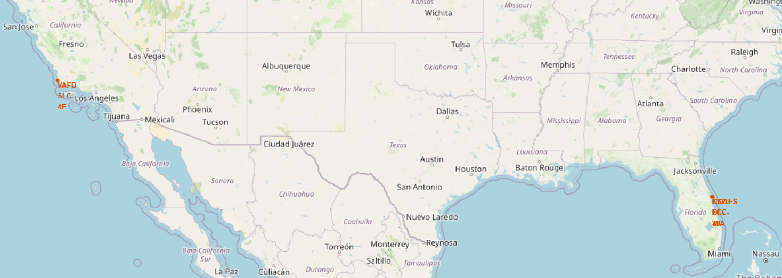
Launch sites' locations
Locations (in red) of the launch sites. As we can see, they are located near coasts.

Slide 36
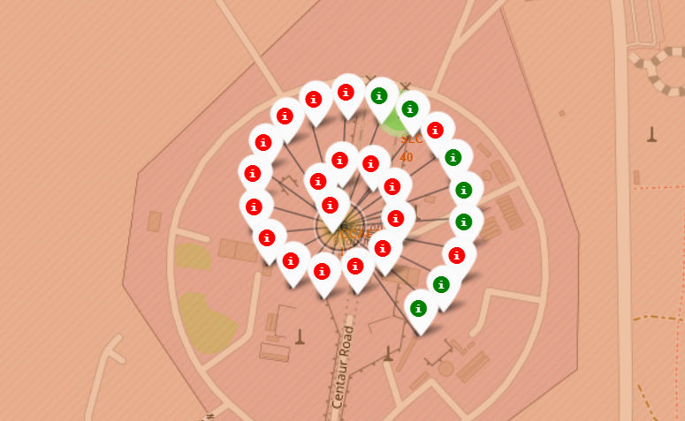
Launch outcomes in one of the launch sites
Below we color-code the success of a launch in a particular launch site. The red ones denote that the first stage of the Falcon line 9 did not land successfully, while green denotes that it succeded.
As we can see, in this particular launch site there were more failures than successes.

Slide 37
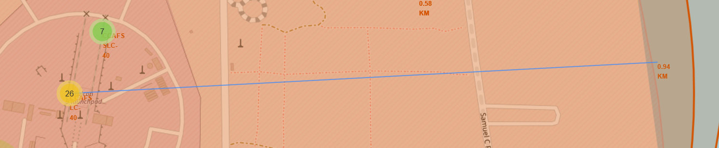
Proximity of one of the launch sites to the coast
Below we illustrate the proximity of one of the launch sites to the coast. We see that there is around 90km to the nearest coastline.

Slide 38

Section 4

Slide 39
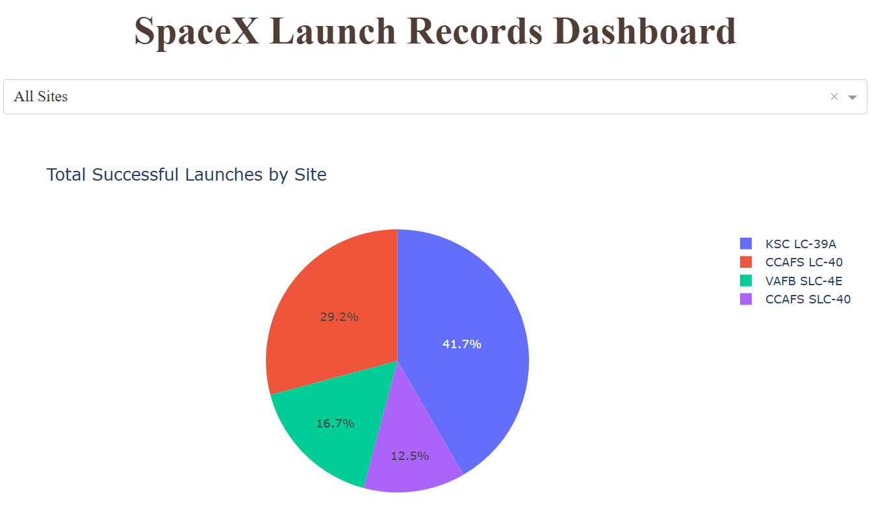
Launch success count for all counts
We plot the total successful launch landings of the first stage by launch site.
We see that the site KSC LC-39A has the most successful first stage launch landings with 41.7%

Slide 40
Launch site with highest launch success ratio
We plot the total successful vs failed launch landings of the first stage for the launch site with highest success ratio.
We see it reaches a 76.9% success ratio.

Slide 41
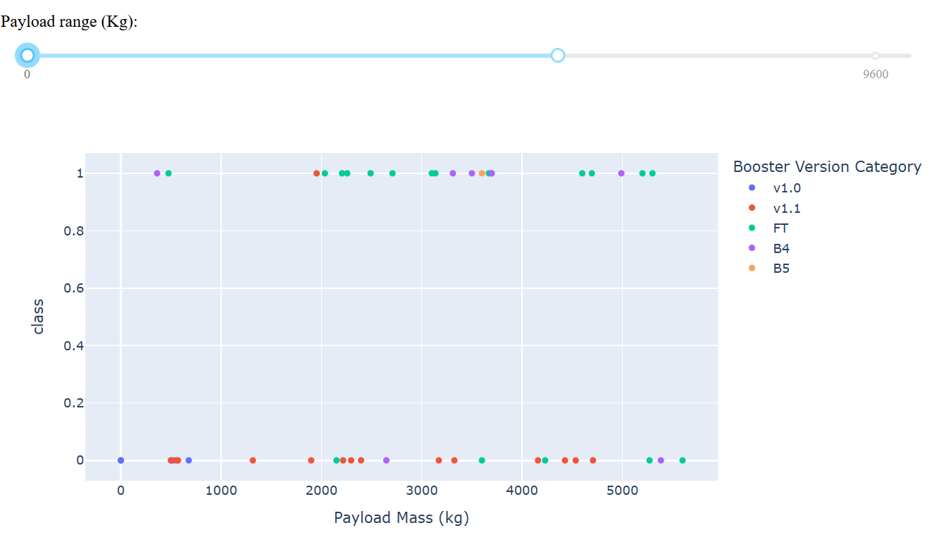
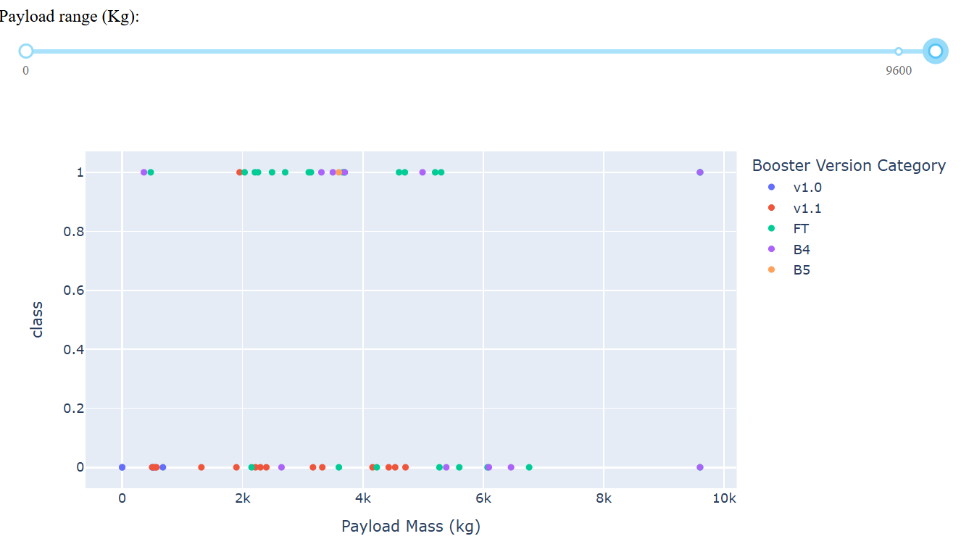
Payload vs. Launch Outcome for all sites
On the first plot, we have the full range of the payload, and see that the booster version FT is overall the one with most successes.
On the second plot, we limit the range to visualize v.1.1 better. We see that it is the booster version that is most likely to fail in this range.

Slide 42

Section 5

Slide 43
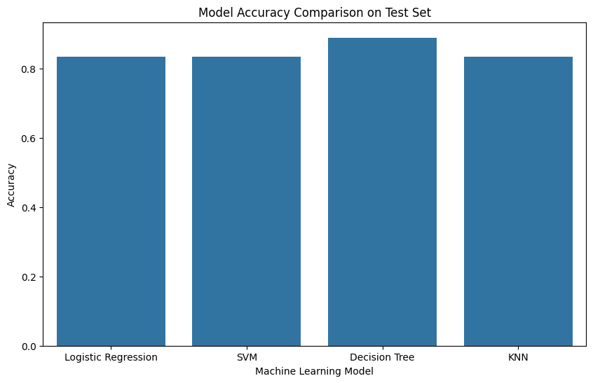
Classification Accuracy
In the bar chart, we illustrate the prediction accuracy on the test set of each model.
We see that the decision tree classifier performed the best, but not by much. The rest of the models had the same accuracy on the test set.

Slide 44

Confusion Matrix
The confusion matrix of the best performing model (the Decision Tree) is shown.
We see that it only had 1 False Positive, and 1 False Negative, with the rest of the predictions being correct.

Slide 45
Conclusions
Of all the models, the decision tree classifier performed the best. However, due to the small size of the test set (18 entries), together with the random initialization of the tree, it may be that it was the best performing only due to chance, of due to not having a big enough test set. This should be studied in more detail, even more so due to the fact that the other models came pretty close to the Decision Tree.
Among the features, the Payload Mass, Flight Number, Orbit type, and year, seem to be correlated to the success of the landing of the first stage.
One should try to complement the pie charts of the Dashboard with the amount of launches per site. The success percentage of a site may lack statistical significance if only a handful of launches were performed on the site compared to others.

Slide 46


